Slide 1
Kentucky Department of Education
Trainings for School Mental Health and Supporting Positive Climate Change.

Slide 2
KDE Training for School Mental Health and Supporting Positive Climate and Culture
KDE’s Division of Student Success provides a variety of trainings that can support school mental health efforts and promote a positive school climate and culture.

Slide 3
Youth Mental Health First Aid (YHMFA)
A free 6-hour course that teaches how to identify, understand and respond to signs of addiction and mental illness. It explains the unique risk factors and warning signs of mental health problems in adolescents ages 12-18 and emphasizes the importance of early intervention.
2021 National Council for Behavioral Health Behavioral Health

Slide 4
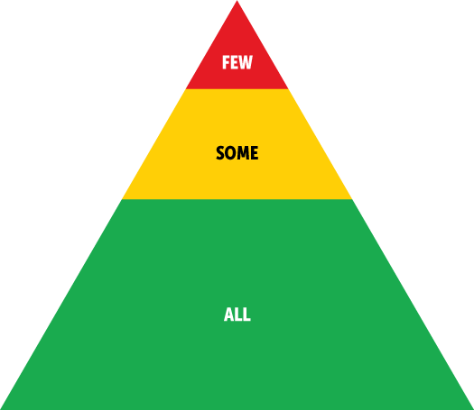
Positive Behavior Interventions and Supports, and Interconnected Systems Framework (PBIS)
Includes a series of trainings designed to improve discipline and school climate, and to reduce the number of restraints, seclusions, and out of school suspensions
© 2021 Positive Behavioral Interventions & Supports (PBIS)

Slide 5
Sources of Strength
Is designed to prevent suicide and violence by using peer leaders to enhance protective factors at the school population level.
sourcesofstrength.org

Slide 6
Olweus Bullying Prevention
Is a research and evidence-based program designed to reduce bullying and improve school climate.
2003-2021 Olweus Bullying Prevention Program

Slide 7
Trauma-Informed Practices for Educators
Is a strengths-based framework grounded in an understanding of and responsiveness to the impact of trauma. It emphasizes physical, psychological, and emotional safety for everyone and creates opportunities for survivors to rebuild a sense of control and empowerment. The Division of Student Success currently works with the Center for Trauma and Children to promote this work.

Slide 8
Mindfulness
To improve mental, emotional, and physical well-being. When applied in the classroom, simple practices can help students experience more inner space and meaning in their lives, and connect on deeper levels to themselves, each other, and educational staff.
2010-2019 Mindful Schools

Slide 9
Resilience Strategies for Educators: Techniques for Self-Care and Peer Support
Is a training developed by the Readiness and Emergency Management for Schools (REMS) TA Center in partnership with the U.S. Department of Education’s (ED) Office of Safe and Healthy Students to assist educators to better understand resilience strategies that can be used to increase their ability to work more effectively with students impacted by stress, loss, and trauma brought on by community or family violence, natural and man-made disasters, and economic hardship.
rems.ed.gov

Slide 10
Training Contact Information
For more information and scheduling of any of these trainings, contact Regina Dawson at regina.dawson@education.ky.gov, or 502-564-4772, extension 4037
Youth Mental Health First Aid (YHMFA): please contact Deborah Sauber at 502-564-4772, extension 4043.
Olweus Bullying Prevention :For more information about Olweus, please contact Deborah Sauber at 502-564-4772, extension 4043.

